Slide 1
Stanford ME469: Multiphysics Coupling
Stefan P. Domino
Computational Thermal and Fluid Mechanics
Sandia National Laboratories SAND2018-4536 PE

Slide 2
Multiphysics Coupling: Outline
Simple Step: Boussinesq Approximaiton
Examples of multiphysics coupling with emphasis on fluids, PMR, and CHT
Monolithic vs Operator Split
Details of PMR/Fluids Coupling
Details of Fluids/Thermal Coupling
Details of PMR/Thermal Coupling
Verification
Stability
Conclusions

Slide 3
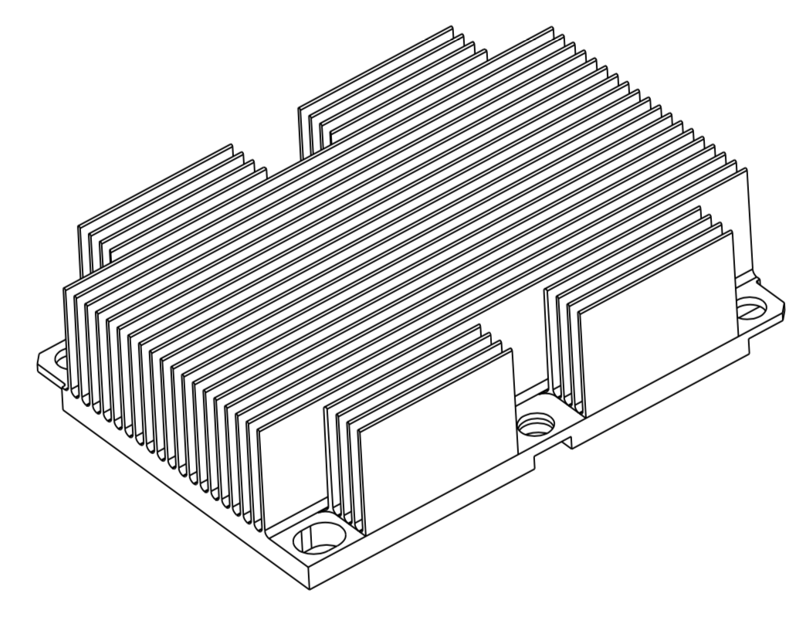
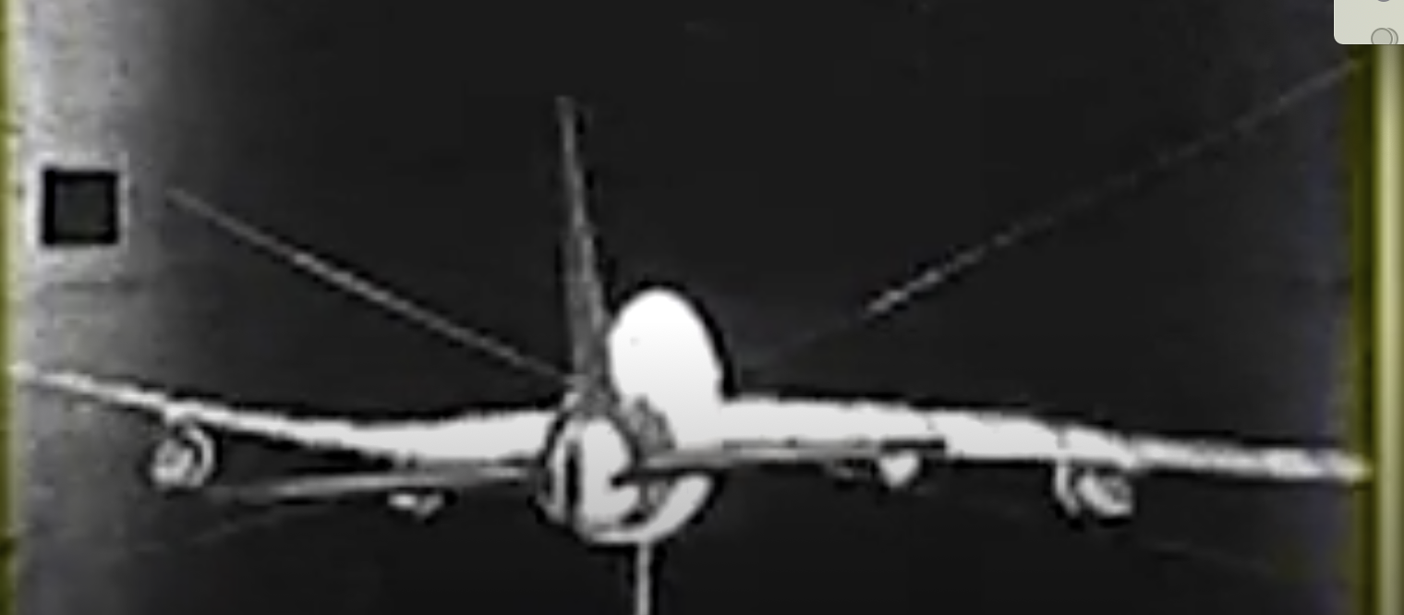
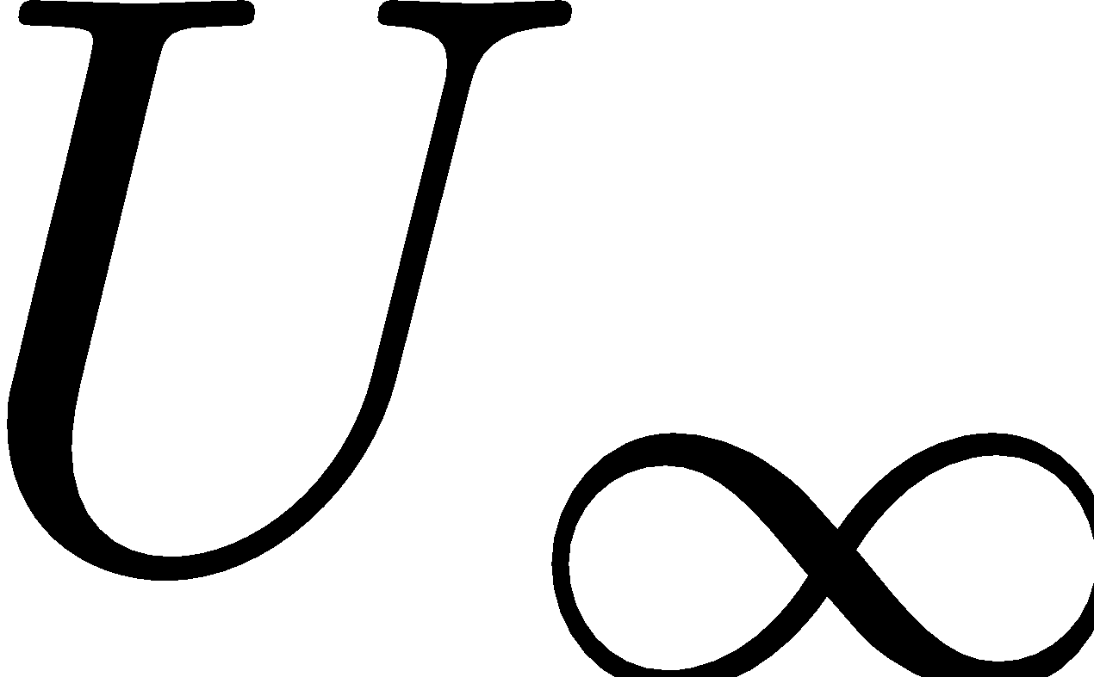
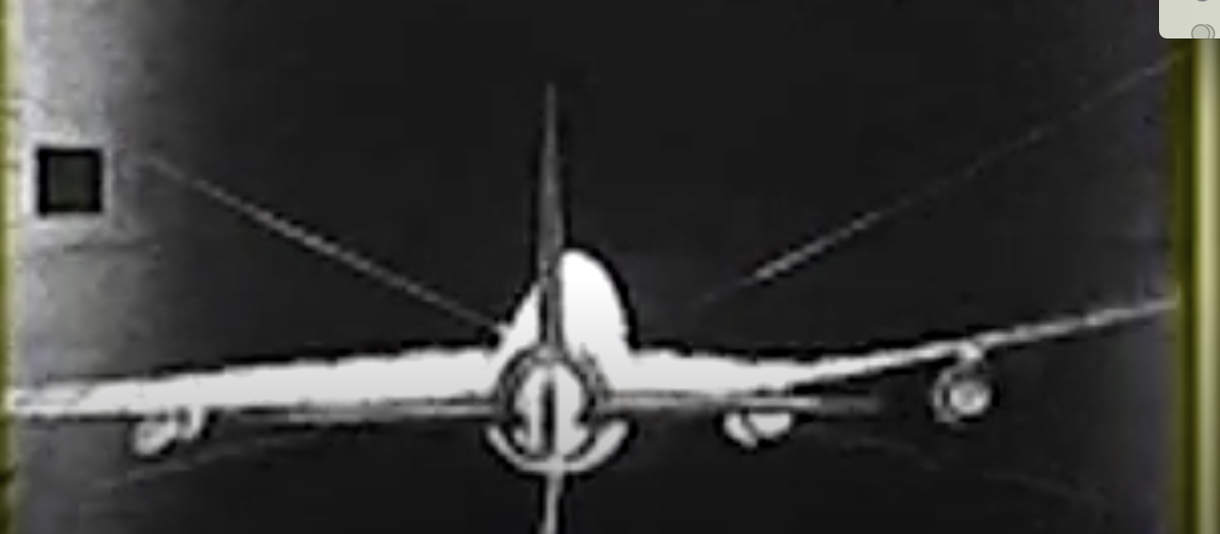
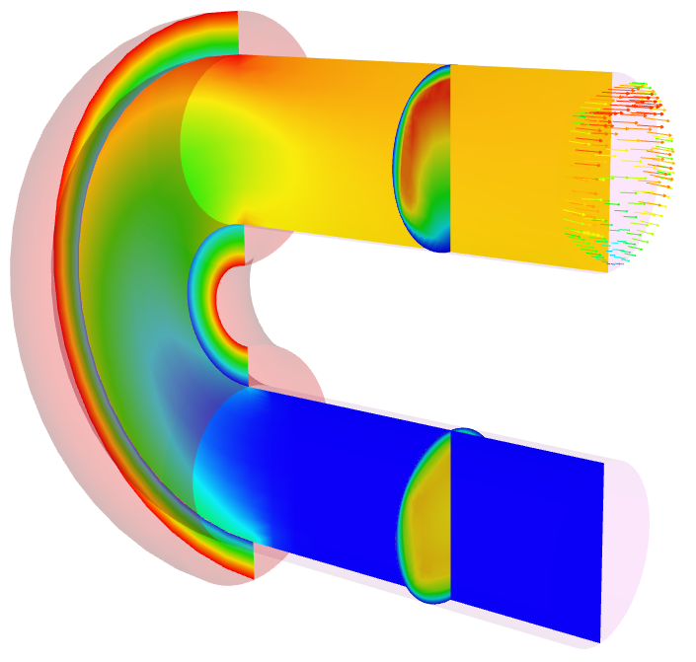
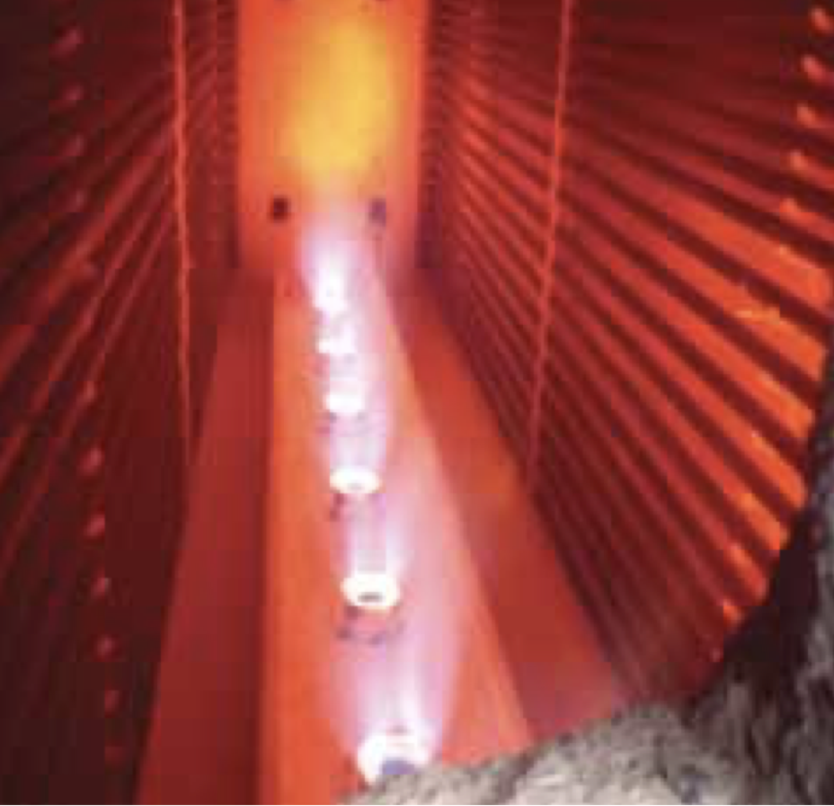
We Live in a Multiphysics World
Fluid/Structure coupling:
Wind turbines
Wing fluttering, etc.
Non-isothermal fluids/participating media radiation:
Fires,
Natural gas and coal combustion,
Smelting, ethylene production, etc.
Conjugate heat transfer:
Object-in-fire
Gas turbine fine cooling
Often times, we note a time and length scale disparity
For example, consider heating a pan on a home burner
The coupling architect must generally choose between monolithic and split
For monolithic, the equations are provided, therefore, the challenge becomes managing a monolithic system solve, storage and code design
For operator split, there can be an “art” in determination of stable couplings due to Eignevalue spread
Intel® Xeon® Processor Scalable Family Thermal Mechanical Specifications and Design Guide
Wing Flutter on a 747
Erwin Platvoet Charles Baukal, P.E. John Zink Hamworthy Combustion

Slide 4
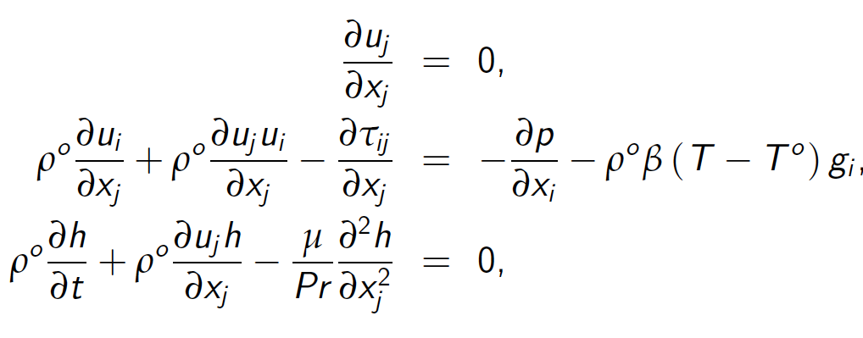
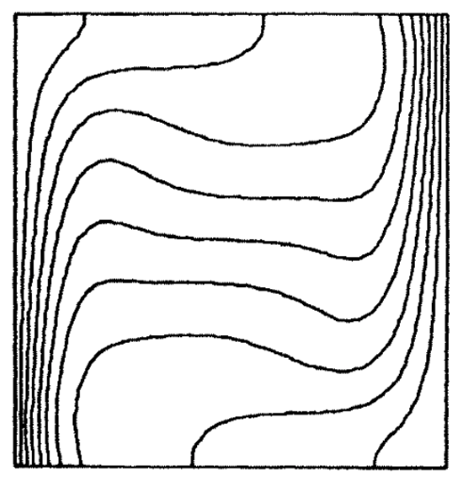
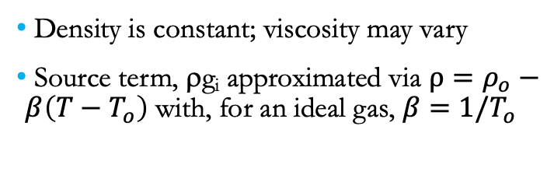
Step 1: Boussinesq Approximation
Thermal
Density is constant; viscosity may vary
Source term, ρg_{i} approximated via $ρ=ρ_{o}−β\left(T−T_{o}\right)$ with, for an ideal gas, $β=1/T_{o}$
Transport of energy through PDE
Temperature
Volume
Convection Coef/Temp .
Fluids
Standard low-Mach
Momentum and Continuity
De Vahl Davis, “NATURAL CONVECTION OF AIR IN A SQUARE CAVITY A BENCH MARK NUMERICAL SOLUTION”, Int. J. Numer. Method. Fluids (1983)

Slide 5
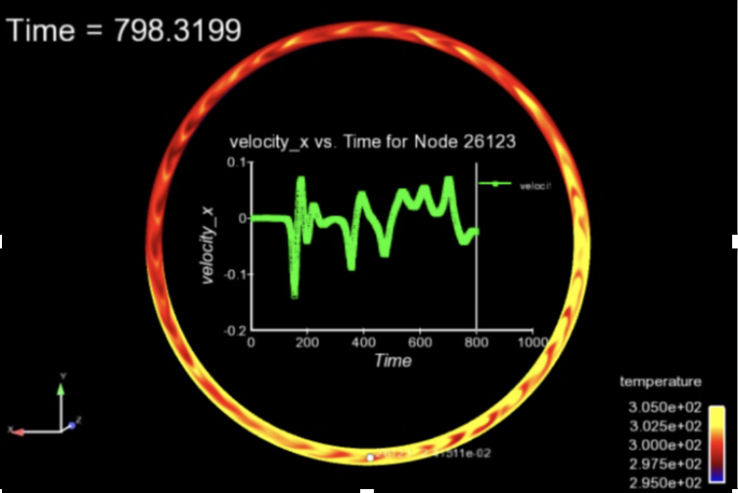
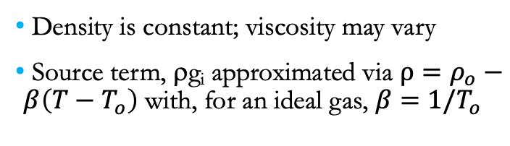
Step 1: Boussinesq Approximation
Thermal
Density is constant; viscosity may vary
Source term, ρg_{i} approximated via $ρ=ρ_{o}−β\left(T−T_{o}\right)$ with, for an ideal gas, $β=1/T_{o}$
Transport of energy through PDE
Temperature
Volume
Convection Coef/Temp .
Fluids
As we have seen for our final, water can be used
Standard low-Mach
Momentum and Continuity

Slide 6
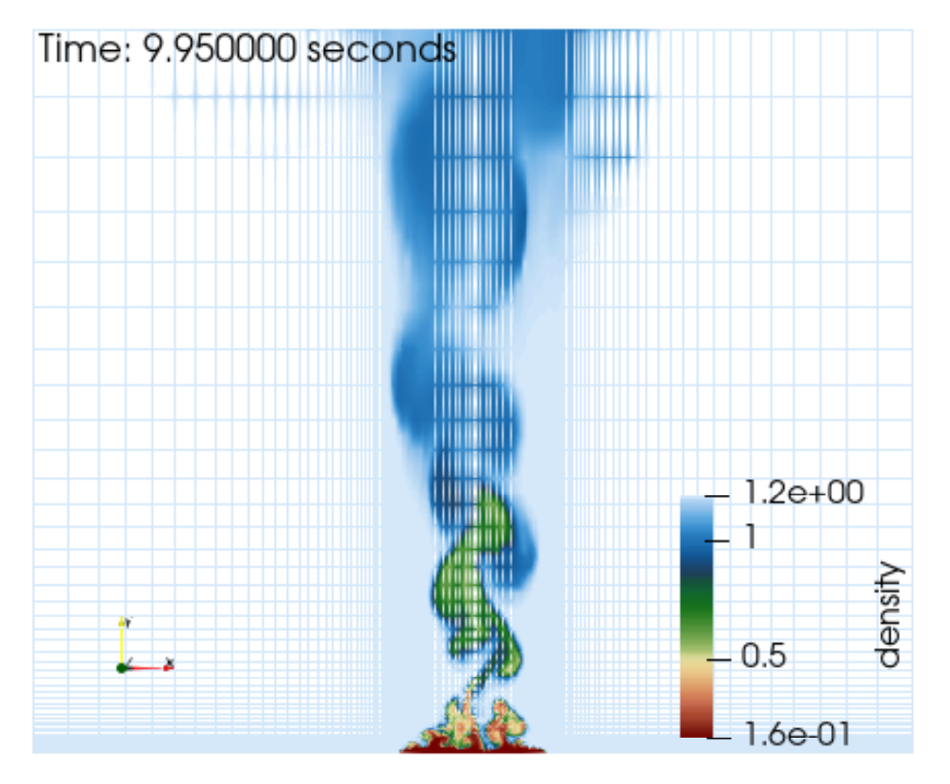
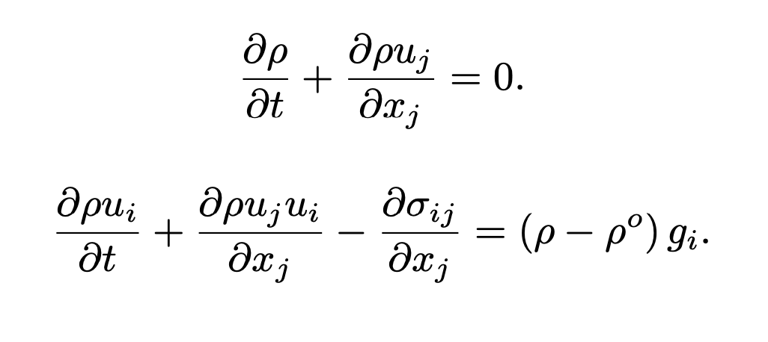
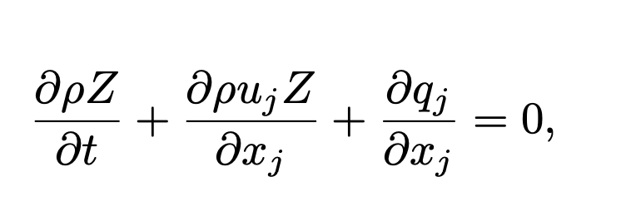
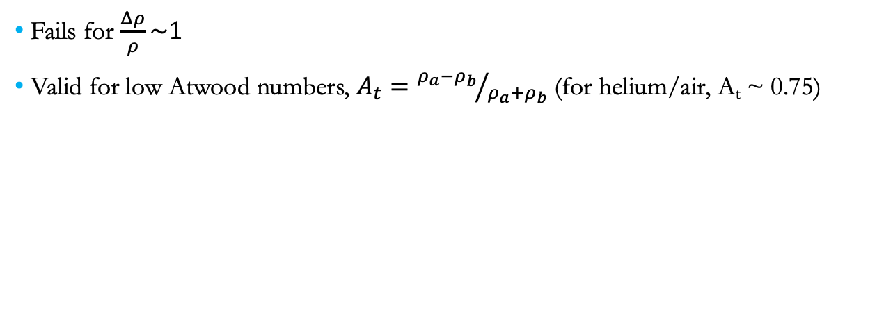
When Does the Boussinesq Approximation Fail?
Fails for $\frac{Δρ}{ρ}\sim 1$
Valid for low Atwood numbers, $A_{t}={ρ_{a}−ρ_{b}}/{ρ_{a}+ρ_{b}}$ (for helium/air, A_{t} ~ 0.75)
2D slice of 1 meter helium plume

Slide 7
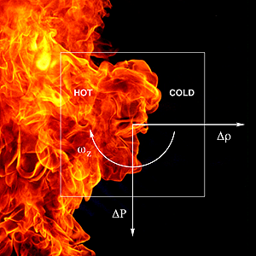
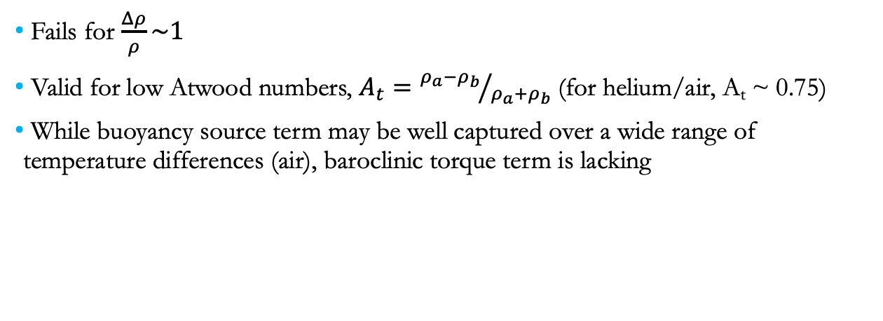
Why Does the Boussinesq Approximation Fail?
Fails for $\frac{Δρ}{ρ}\sim 1$
Valid for low Atwood numbers, $A_{t}={ρ_{a}−ρ_{b}}/{ρ_{a}+ρ_{b}}$ (for helium/air, A_{t} ~ 0.75)
While buoyancy source term may be well captured over a wide range of temperature differences (air), baroclinic torque term is lacking
2D slice of 1 meter helium plume

Slide 8
Poor Boussinesq Approximation
Fails for $\frac{Δρ}{ρ}\sim 1$
Valid for low Atwood numbers, $A_{t}={ρ_{a}−ρ_{b}}/{ρ_{a}+ρ_{b}}$ (for helium/air, A_{t} ~ 0.75)
While buoyancy source term may be well captured over a wide range of temperature differences (air), baroclinic torque term is lacking
Note: Hydrostatic pressure has been subtracted from motion pressure
2D slice of 1 meter helium plume

Slide 9
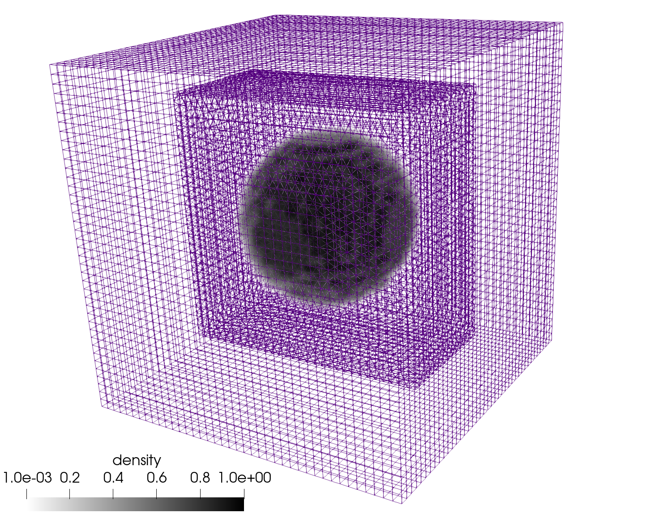
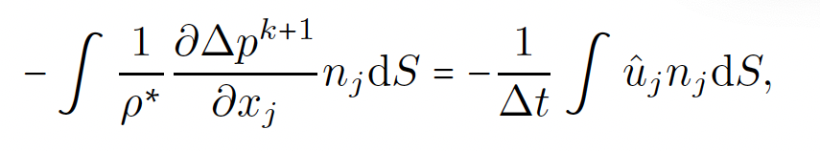
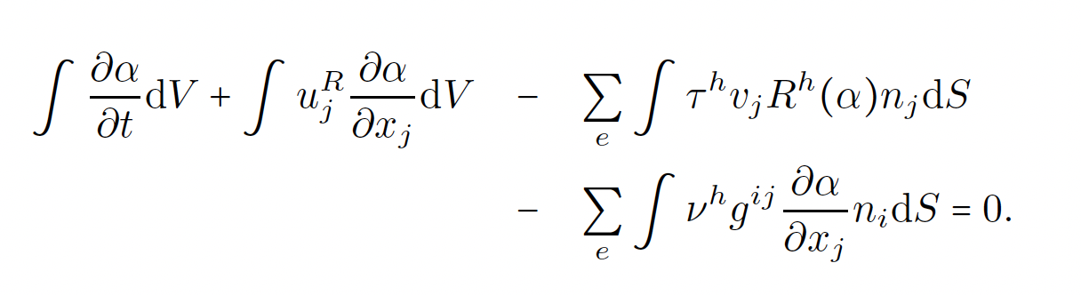
Other Variable-Density Cases: Volume of Fluid (VOF)
Balanced Force (Francois, JCP, 2006) ported to CVFEM
Parasitic currents suppressed via a consistent momentum/continuity stabilization approach
Stabilization provided through residual-based approaches
Hex8/Tet4 Balanced force static bubble, density ratio = 1000

Slide 10
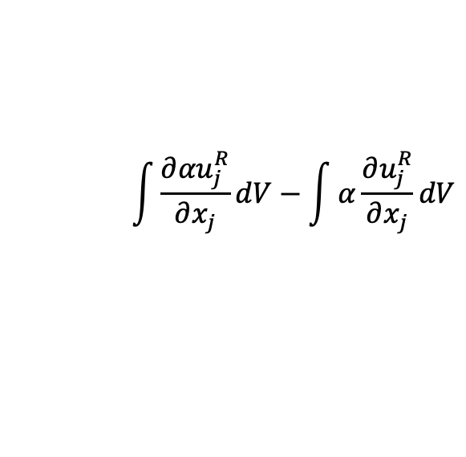
Other Variable-Density Cases: Volume of Fluid (VOF)
Balanced Force (Francois, JCP, 2006) ported to CVFEM
Parasitic currents suppressed via a consistent momentum/continuity stabilization approach
Stabilization provided through residual-based approaches
Hex8/Tet4 Balanced force static bubble, density ratio = 1000
$$\int{\frac{∂{αu}_{j}^{R}}{∂x_{j}}}dV−\int{α\frac{∂u_{j}^{R}}{∂x_{j}}}dV$$
Central + upwind blending, etc…

Slide 11
Other Variable-Density Cases: Volume of Fluid (VOF)
Balanced Force (Francois, JCP, 2006) ported to CVFEM
Parasitic currents suppressed via a consistent momentum/continuity stabilization approach
Stabilization provided through residual-based approaches
Hex8/Tet4 Balanced force static bubble, density ratio = 1000
Alternative: residual-based SUCV + NSP

Slide 12
Coupling Choice
Implicit Monolithic vs Segregated
Explicit, multi-stage RK schemes
do while (!converged) {
}
For a given
time step:

Slide 13
Coupling Definitions: Monolithic
Fully Coupled, or Monolithic
One equation system, one solve
{
do while (!converged) {
}
For a given
time step:
Reduced radius of convergence
Second order convergence

Slide 14
Coupling Definitions: Segregated
Loosely Coupled, or Segregated
Multiple matrix systems solved within a Picard linearization, i.e., Jacobi or Gauss-Seidel iteration. Coupling is two-way (or multiple way if the physics becomes really complex)
{
do while (!converged) {
}
For a given
time step:
Every equation is segregated..
Larger radius of convergence
Often, first order convergence
Larger radius of convergence
Often, stagnates to first-order convergence

Slide 15
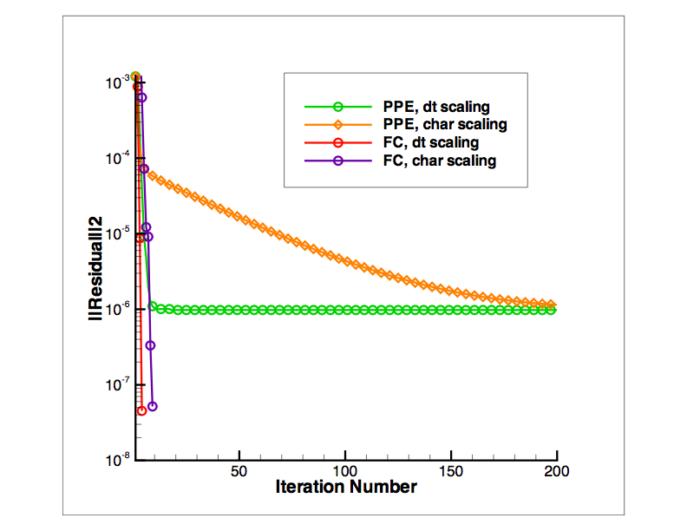
Nonlinear Convergence Comparisons
Low- vs high-frequency errors
A segregated scheme removes high-frequency errors quite efficiently while low-frequency errors persist (think multi-grid)
A monolithic scheme removes low-frequency errors while struggles with high-frequency errors

Slide 16
Objective: Stable, Time-Accurate Solutions
A full monolithic approach requires a flexible code base and efficient solvers
A full segregated or split coupling approach requires detailed analysis to ensure that the splitting is:
Design-order, i.e., no lurking spatial or temporal error
Stable, i.e., with subsequent time advancement, the solution remains bounded

Slide 17
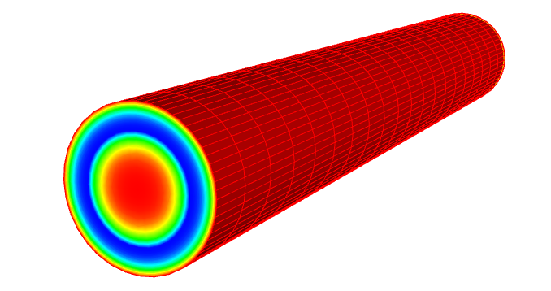
Conjugate Heat Transfer Coupling
Thermal
Common in engineering applications that require efficient heating or cooling of objects
Conduction
Heat Transfer,
Enclosure Radiation
1 DOF/node
+ chemistry
Tb
Temperature
SURFACE
Convection Coef/Temp .
Fluids
Turbulent
Fluid Mechanics,
Combustion
15 dof/node
Tb
Turbulent pipe CHT

Slide 18
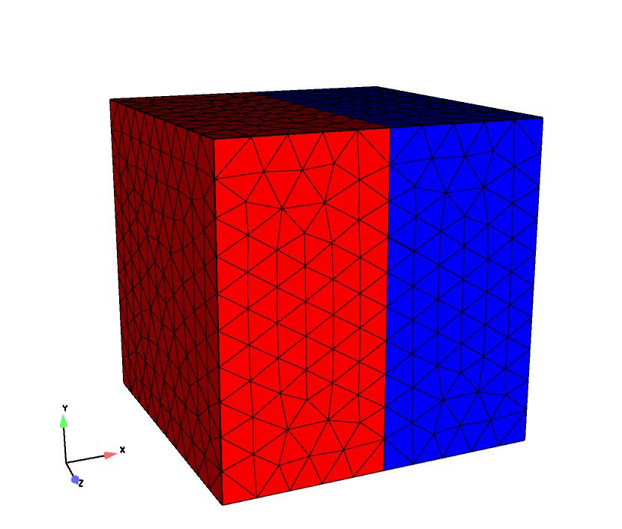
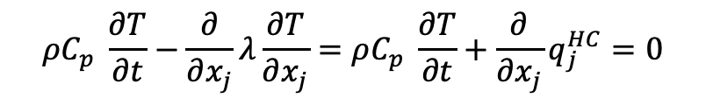
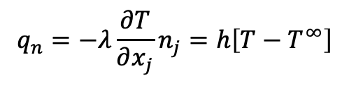
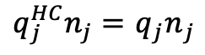
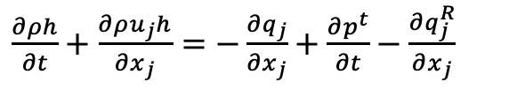
Conjugate Heat Transfer Coupling, Equations
Favre-averaged static enthalpy equation:
Thermal heat conduction
Interface condition
$\frac{∂ρh}{∂t}+\frac{∂ρu_{j}h}{∂x_{j}}$ $=−\frac{∂q_{j}}{∂x_{j}}+\frac{∂p^{t}}{∂t}−\frac{∂q_{j}^{R}}{∂x_{j}}$
$$ρC_{p} \frac{∂T}{∂t}−\frac{∂}{∂x_{j}}λ\frac{∂T}{∂x_{j}}=ρC_{p} \frac{∂T}{∂t}+\frac{∂}{∂x_{j}}q_{j}^{HC}=0$$
$$q_{n}=−λ\frac{∂T}{∂x_{j}}n_{j}=h\left[T−T^{∞}\right]$$
$q_{j}^{HC}n_{j}=$ ${q_{j}n}_{j}$

Slide 19
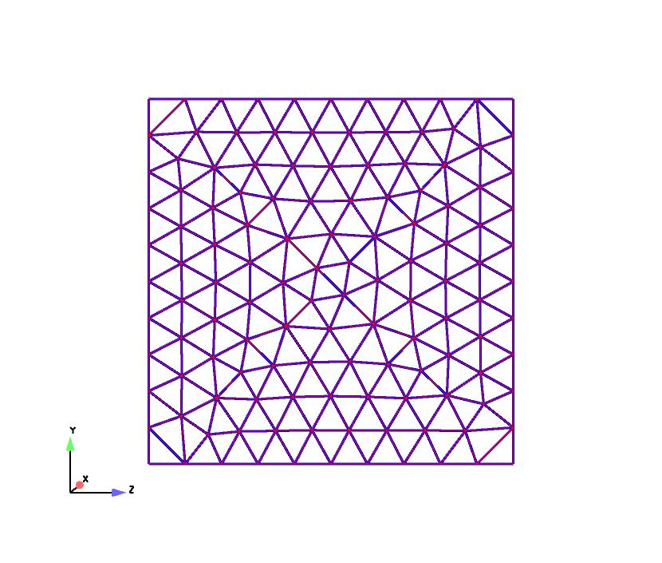

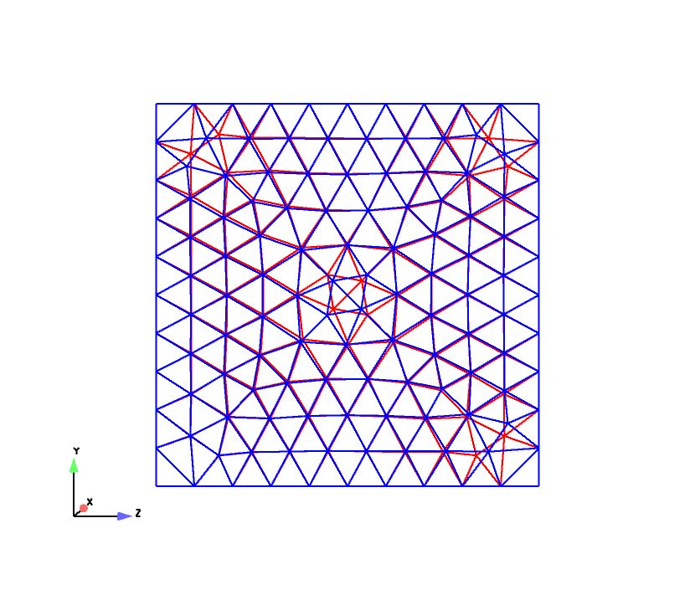
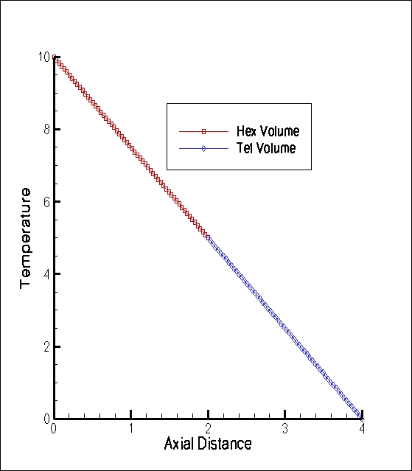
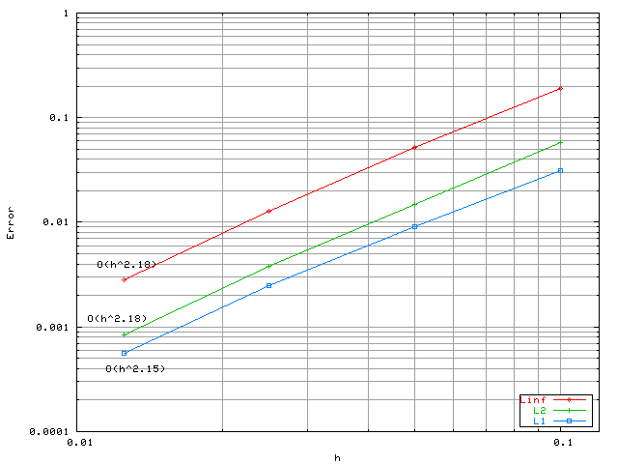
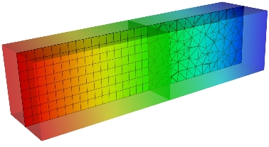
Fluid/CHT Coupling Verification
Unstructured heterogeneous mesh capability
Arbitrary geometric complexity
Multi-block domain variable transfer
Conforming interface
Non-
conforming interface
Linear (patch test)
Trigometric MMS

Slide 20
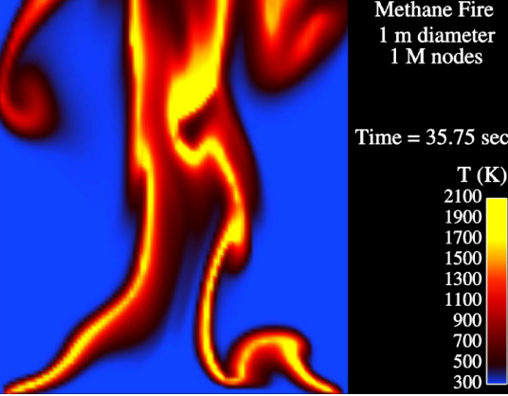
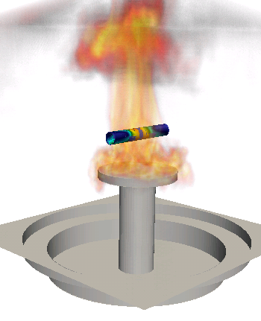
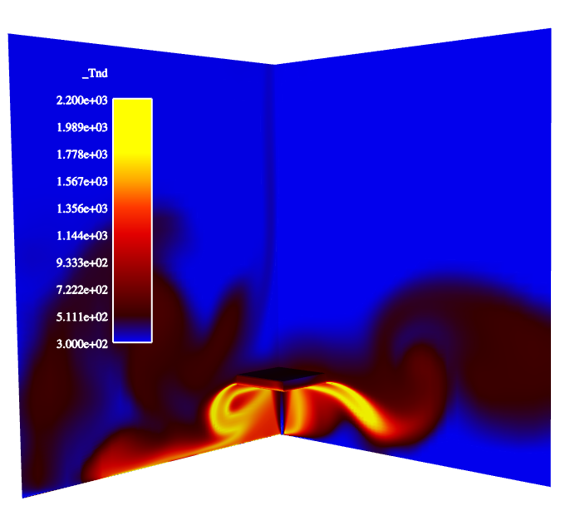
Fluids/PMR Coupling
PMR
Participating
Media
Radiation
n(n+2) DOF/node
T, μ, S_{RTE}
Pool fire
VOLUME
Fluids
Turbulent
Fluid Mechanics,
Combustion
15 dof/node
Deflected reacting jet

Slide 21
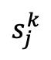
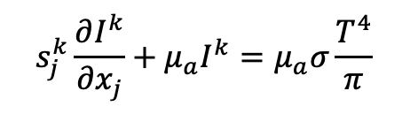
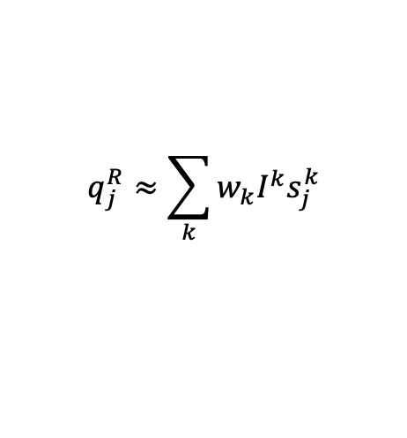
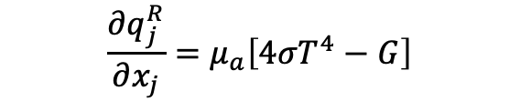
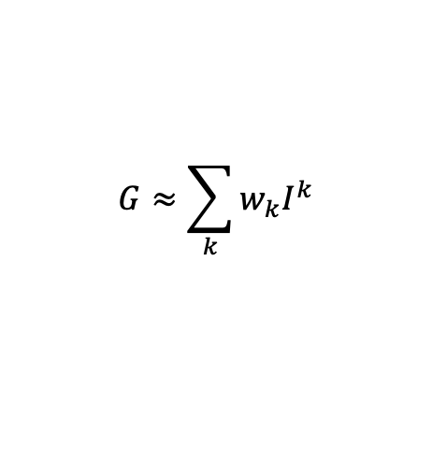
Fluids/PMR Coupling Equations
Favre-averaged static enthalpy equation:
Steady, non-scattering Radiative Transport Equation
Scalar Flux,
Divergence of radiative flux,
$\frac{∂ρh}{∂t}+\frac{∂ρu_{j}h}{∂x_{j}}$ $=−\frac{∂q_{j}}{∂x_{j}}+\frac{∂p^{t}}{∂t}−\frac{∂q_{j}^{R}}{∂x_{j}}$
$$s_{j}^{k}\frac{∂I^{k}}{∂x_{j}}+μ_{a}I^{k}=μ_{a}σ\frac{T^{4}}{π}$$
$$G≈\sum_{k}{w_{k}I^{k}}$$
$$s_{j}^{k}$$
$$q_{j}^{R}≈\sum_{k}{w_{k}I^{k}s_{j}^{k}}$$
$$\frac{∂q_{j}^{R}}{∂x_{j}}=μ_{a}\left[4{σT}^{4}−G\right]$$
Quadrature

Slide 22
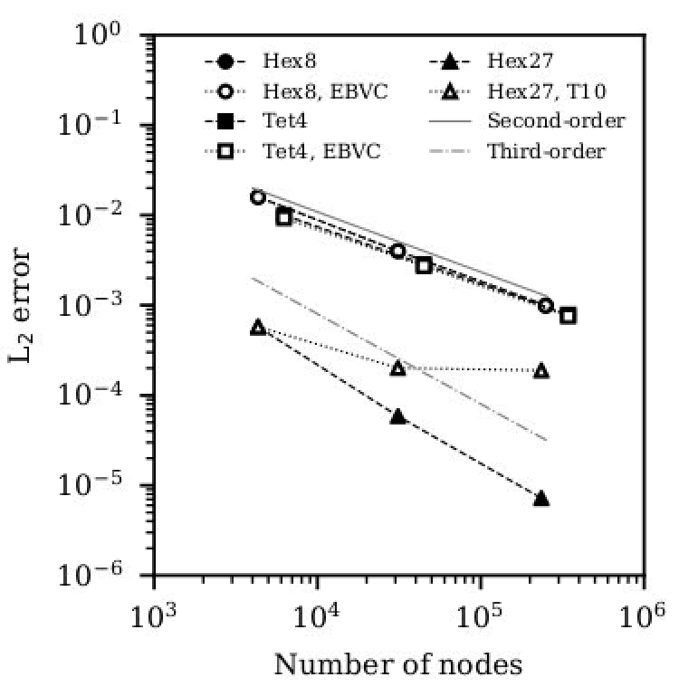
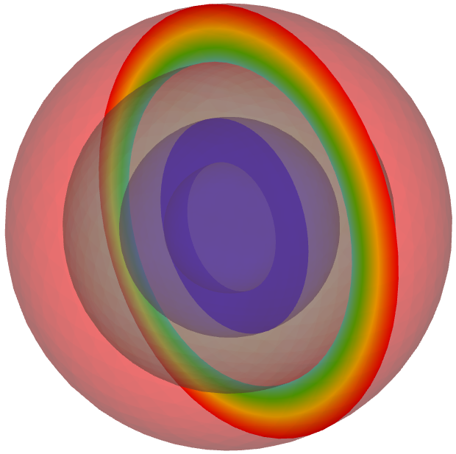
PMR/Thermal Coupling
Thermal
Temperature
PMR
Conduction
Heat Transfer,
Enclosure Radiation
1 DOF/node
+ chemistry
SURFACE
Participating
Media
Radiation
n(n+2) DOF/node
Irradiation
r_{o}, T_{o} = 0.1 m, 600K
r₂, T₂ = 0.075 m, 599.291K
r₁, T₁ = 0.05 m, 302.834K
r_{i}, T_{i} = 0.03 m, 300K
PMR:Conduction through concentric spheres
Reduced Order-of-accuracy due to quadrature and/or faceting

Slide 23
Multi-Mechanics Boundary Condition Verification
Details for heat conduction coupling to PMR and fluids
Dirichlet condition
Fluids
PMR

Slide 24
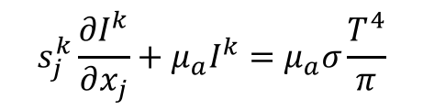
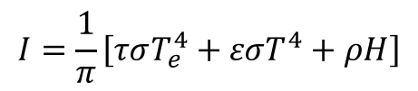
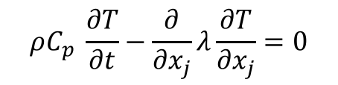
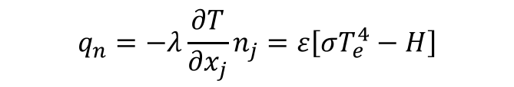
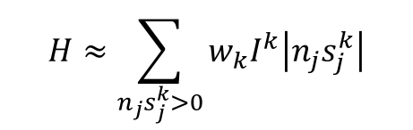
PMR/Thermal Coupling Equations
Steady, non-scattering Radiative Transport Equation
Irradiation (incoming),
Grey, diffuse boundary condition (given transmissivity, τ, emissivity ε, and reflectivity, ρ
With boundary condition,
$$s_{j}^{k}\frac{∂I^{k}}{∂x_{j}}+μ_{a}I^{k}=μ_{a}σ\frac{T^{4}}{π}$$
$$H≈\sum_{n_{j}s_{j}^{k}>0}{w_{k}I^{k}\left|n_{j}s_{j}^{k}\right|}$$
$$I=\frac{1}{π}\left[τσT_{e}^{4}+εσT^{4}+ρH\right]$$
$$q_{n}=−λ\frac{∂T}{∂x_{j}}n_{j}=ε\left[σT_{e}^{4}−H\right]$$
$$ρC_{p} \frac{∂T}{∂t}−\frac{∂}{∂x_{j}}λ\frac{∂T}{∂x_{j}}=0$$

Slide 25
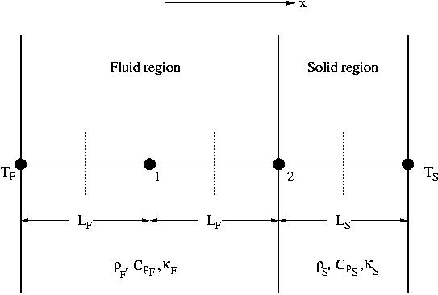
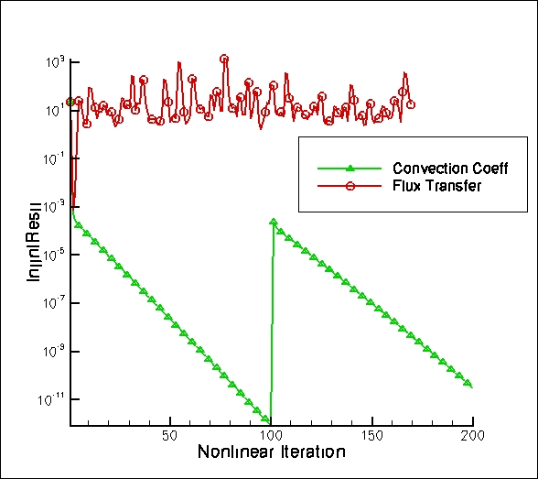


Stability of Operator Split CHT Approaches
Thermal
Compute amplification factor: T^{n+1} = λ T^{n} Require:
CHT via flux transfer:
Unstable for certain Δt and material property ratios
CHT via convection coefficient:
Unconditionally stable, however, Δt error
Conduction
Heat Transfer,
Enclosure Radiation
1 DOF/node
+ chemistry
$q_{j}^{HC}n_{j}=$ ${q_{j}n}_{j}$
$$q_{n}=−λ\frac{∂T}{∂x_{j}}n_{j}=h\left[T−T^{∞}\right]$$
Temperature
SURFACE
Convection Coef/Temp .
T^{spec}
Simplified 1D geometry with 2 nodes for stability analysis of CHT
Fluids
outflow
Turbulent
Fluid Mechanics,
Combustion
15 dof/node
inflow

Slide 26




Conjugate Heat Transfer Coupling: In Practice
Using the control volume finite element method (CVFEM) – a Petrov-Galerkin approach
Using a Lagrange polynomial, and definition of element coefficients, interpolation is given by,
While gradients in temperature can be written as,
$$T\left(x_{k}\right)≈\sum_{i=1}^{npe}{N_{i}\left(x_{k}\right)T_{i}}$$
$$\frac{∂T\left(x_{k}\right)}{∂x_{j}}≈\sum_{i=1}^{npe}{{\frac{∂N_{i}\left(x_{k}\right)}{∂x_{j}}T}_{i}}$$
Thermal
1^{A}
1^{F}
Fluid
2
ε
Δx
$−λ\frac{∂T}{∂x_{j}}n_{j}=−λ\frac{∂N_{1}}{∂x}T_{1}$ $n_{x}−λ\frac{∂N_{2}}{∂x}T_{2} n_{x}=h(T_{1}−T^{∞}$)
“on the wall”, T₁ terms collect to h
“off the wall”, T₂ terms collect to T^{oo}

Slide 27



Conjugate Heat Transfer Coupling: Mathematical Construct
Given the definitions of the shape function derivatives on this simple 1D example,
Notes:
Regardless of flow physics, the heat transfer coefficient is always a function of the first mesh spacing
For high convective loads, this approach may not maximize stability of the Aria solve
However, we can arbitrarily increase h and modify T^{oo} consistently to achieve a larger diagonal dominance at the Aria system
We can also allow for h to be based on a physical bulk temperature, e.g., T^{user}
Mandate: Modify the reference temperature and convection coefficient that thermal solution uses to ensure a consistent flux transfer between the CHT interface
$$h=\frac{λ}{∆x}$$
$$T^{∞} =T_{2}$$
$$h=\frac{−λ\frac{∂T}{∂x}n_{x}}{T_{1}−T^{user}}$$

Slide 28



Conjugate Heat Transfer Coupling: Example
Flow past heated cylinder, Re = 1200
Water, T^{cyl} = 300C
Former analysis shows h = 5000 W/(m² K) – fixed while user-based approach would provide ~2000 W/(m² K)
Correlation provides h = 1500 W/(m² K)
Modified post-processing based on inflow temperature
$$h^{user}=\frac{−λ\frac{∂T}{∂x}n_{x}}{T_{s}−T^{inflow}}$$
In this case, using a smaller h would reduce thermal solve’s diagonal dominance, however, would resonate with a typical ChemEngr or MechEngr
lhs += Int w h (T – T^{oo}) dA

Slide 29




Other Linearization Procedures
PMR and heat conduction radiative boundary condition:
PMR and fluids coupling, linearized divergence of the radiative flux,
In practice, such procedures enhance stability for the multi-physics coupling
In the case of Fluids/CHT, one could possibly monolithically couple the systems
In the case of Fluids/PMR, monolithic coupling is not practical as the intensity system is ~ N², where N is generally O(8)
$$q_{n}=−λ\frac{∂T}{∂x_{j}}n_{j}=ε\left[σT^{4}−H\right]$$
$$lhs∝ \frac{∂}{∂T}ε\left[σT^{4}−H\right]=4εσT_{e}^{3}$$
$$\frac{∂q_{j}^{R}}{∂x_{j}}=μ_{a}\left[4{σT}^{4}−G\right]$$
$$lhs∝ \frac{∂}{∂T}μ_{a}\left[4{σT}^{4}−G\right]=16μ_{a}σT^{3}\frac{1}{C_{p}}$$

Slide 30
Fire Mechanics Coupling Description (in words)
Temperature
Irradiation
Conduction
Heat Transfer,
Enclosure Radiation
SURFACE
Participating
Media
Radiation DOM
Operator-split
Transfer
Temperature, μ_{g}
RTE Src
Linearized
Temperature
Convection Coef.
Reference Temp
SURFACE
۰q_{r}
VOLUME
Δ
Turbulent
Fluid Mechanics,
Combustion
Monolithic, i.e., fully coupled, approaches are intractable due to the size of (u, v, w, p, h, h^{r}, Z, I^{k} , T)^{T}
Stable and accurate operator split methods are, therefore, sought
See Domino et al., AIAA, 2007
Alternative: Monolithic
hybrid DG/CVFEM fluid/thermal coupling (stay tuned)

Slide 31
Low-Mach Turbulent Reacting Flow Equation Set
Favre-averaged, variable-density, low-Mach equation set using large-eddy simulation (LES)
Acoustics are filtered via the low-Mach derivation (Rehm and Baum, J. Research NBS, 1978; Paolucci, SAND, 1982)
Given filter:
Subgrid Stress (SGS):
mixture fraction-based unsteady flamelet combustion with generalized heat loss (multi-D table look-up; presumed PDF)
Soot: Koo et al. (2018) from Moss and Askit (2007)
Closure:
LES Models:
Smagorinsky:
Ksgs:
WALE:

Slide 32


Thermal Radiation Technique: Discrete Ordinate Method (DOM)
Definitions:
I^{k} = Intensity for ordinate k
s^{k}_{j} = ordinate k for direction j
w = test function
N = quadrature set, e.g., 2, 4, 6, .., 12
Radiative Transport Equation (RTE) approach attributes:
Requires discretization, stabilization, quadrature set, T^{g}, μ_{a}, μ_{s}, etc.
A meshed interior “volume”; Note: ε =f(Δx^{n},N)
Large set of sparse linear solves ~ 8N² (Thurgood); N ~ 4
Path forward: conservative Streamwise Upwind Control Volume (SUCV) stabilization motivated by SUPG Burns et al.., Ntl. Heat Trans Conf., 1995, provided by Domino, SAND, 2014; Domino et al., Phy. Fluids (2021)
s^{k}_{j}
${ s}_{j}^{k}\frac{∂I^{k}}{∂x_{j}}+\left(μ_{a}+μ_{s}\right)$ $I^{k}=\frac{μ_{a}σT^{4}}{π}$+ $\frac{μ_{s}G}{4π}$
$$\int{\tilde{w}\left(s_{j}^{k}\frac{∂I^{k}}{∂x_{j}}+\left(μ_{a}+μ_{s}\right) I^{k}−\left(\frac{μ_{a}σT^{4}}{π}\text{+} \frac{μ_{s}G}{4π}\right)\right)}dV=0$$
$$\int{s_{j}^{k}I^{k}n_{j}dS+\int{\left(\left(μ_{a}+μ_{s}\right) I^{k}−S\right)dV}}=\int{τs_{j}^{k}{R^{k}n}_{j}dS}$$
$$G≈\sum_{k}{w_{k}I^{k}}$$
5 meter JP-8 Pool Fire
temperature and absorption coeff
RTE with isotropic scattering

Slide 33
Thermal (heat conduction) and multi-physics coupling
The quantity of interest is generally thermal response, T = f(t,x_{i}), and incident radiative flux, H
Thermal Equation (simple):
Thermal interface coupling:
$$ρC_{p} \frac{∂T}{∂t}−\frac{∂}{∂x_{j}}λ\frac{∂T}{∂x_{j}}=0$$
$$q_{n}=−λ\frac{∂T^{s}}{∂x_{j}}n_{j}^{s}=ε\left[σT^{4}−H\right]+h\left(T−T^{∞}\right)$$
Fluids/PMR coupling:
Intensity coupling:
$$\frac{∂q_{j}^{R}}{∂x_{j}}=μ_{a}\left[4{σT}^{4}−G\right]$$
$$I=\frac{1}{π}\left[τσT_{e}^{4}+εσT^{4}+ρH\right]$$
From fluids:
$${T, μ}_{a}, μ_{s}$$
Supplemental:
$$H≈\sum_{n_{j}s_{j}^{k}>0}{w_{k}I^{k}\left|n_{j}s_{j}^{k}\right|}$$
$$G≈\sum_{k}{w_{k}I^{k}}$$

Slide 34

5m JP-8 Pool Fire Validation: Step 2 QoI: Fire physics phenomena such as puffing
Do we observe fire puffing?
Yes, puffing is captured – a key feature found in pool fires due to the complex interaction of Rayleigh/Taylor instabilities, Baroclinic torque, and vertical acceleration of vortical ring structures
Dominant puffing frequency predicted (0.60 Hz)
Well predicted compared to correlation (0.67 Hz)
Notes:
The former V&V method required experts choosing the appropriate LES models (Smagorinsky, Ksgs, and WALE). In most cases, no one (sadly) really evaluates this model-form error.
Choosing multiple models in a V&V credibility effort required coding of the said models, verification of the models, and maintenance, i.e., $$$$. Is there a better way to manage structural uncertainty for LES? Yes, my V&V project in partnership with Stanford is doing this..
Background: In LES, we desire to close the subgrid stress (SGS), or Tau_ij.
This SGS stress is a symmetric tensor that is positive-definite. As such, we can perform an eigenvalue decomposition. The eigenvectors provide an orthonormal basis while the eigenvalues represent the ”weight” towards the limiting types of turbulence: one-component (rods), two-component (pancakes) and three-component (isotropic and circular).
The triangle is a “barycentric triangle” that represents a linear mapping between the eigenvalues to a picture. The shaded triangle is a real simulation where we are probing a point in space and plotting the eigenvalue decomposition (open jet). Any viable model ever dreamed of must fit inside this triangle.
By perturbing the eignevalues and eigenvectors, we can evaluate uncertainty in the LES model. This is really powerful.

Slide 35

Why not simply monolithic CHT?
In some cases, the thermal response is extremely complex, e.g., includes enclosure radiation, thermal resistance, multiple interior fluids, etc.
For such complex cases, it may be best to operator split
However, if the thermal response is simple, then one might explore a multi-material non-conformal scheme, e.g., Domino, JCP, 2018
Other monolithic opportunities exist
Non-conformal MMS

Slide 36
Multiphysics Coupling: Conclusions
Multiphysics applications are abundant in engineering applications
Turbulent, reacting flow with PMR and CHT requires a wide range of length and time scale resolution
Monolithic approaches are ideal from a splitting perspective, however, can be prohibitively expensive when considering systems such as PMR
Linearization can augment time step stability and should be exploited when possible

Slide 37
Multiphysics Coupling: Conclusions
Multiphysics applications are abundant in engineering applications
Turbulent, reacting flow with PMR and CHT requires a wide range of length and time scale resolution
Monolithic approaches are ideal from a splitting perspective, however, can be prohibitively expensive when considering systems such as PMR
Linearization can augment time step stability and should be exploited when possible
Multiphysics Application
Operator split
Stability
Accuracy
Data transfer
Build system
Time-scale disparity
Monolithic
Efficient solvers
Flexible code design
Non-conformal interfaces
Time-scale disparity

